Slide 1


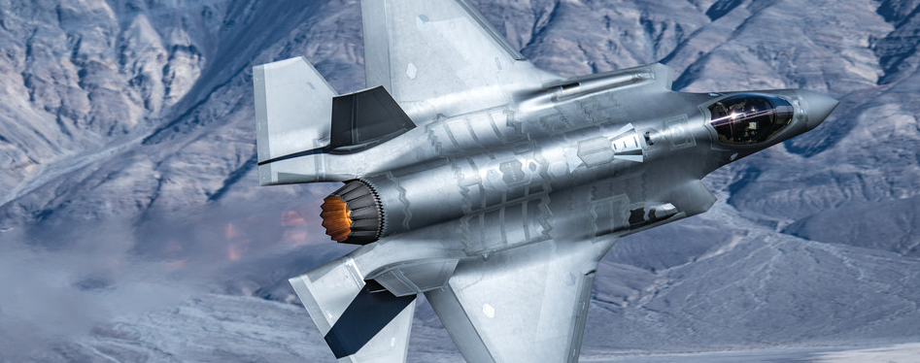
GKN Fokker Elmo Informal Knowledge Model
KBE Assignment 2022
Cor Zoon & Stijn Wulffraat

Slide 2
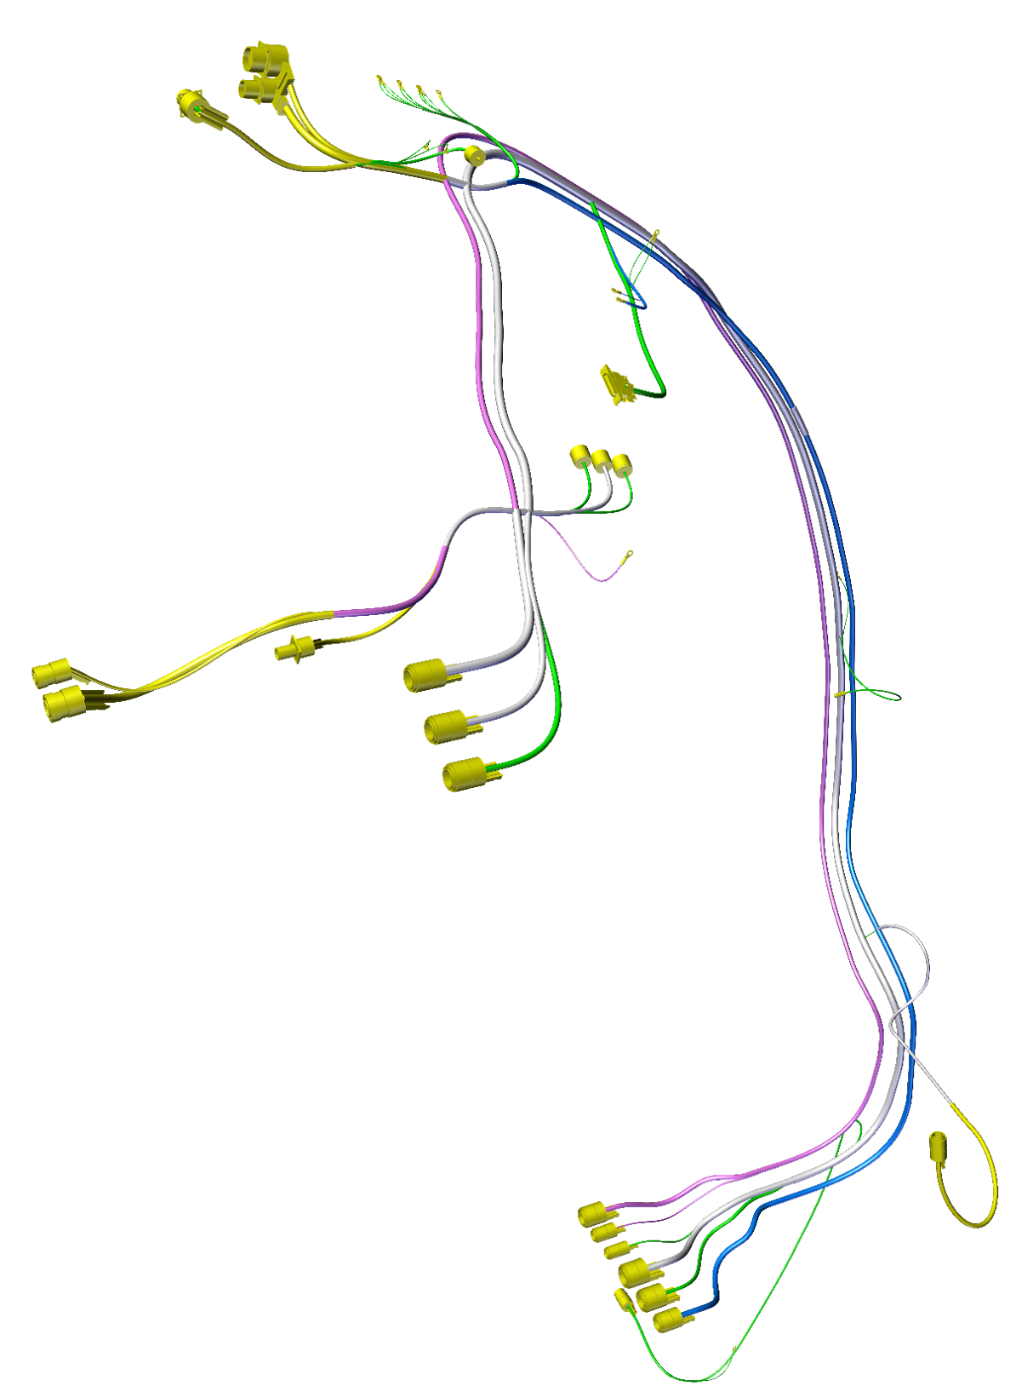
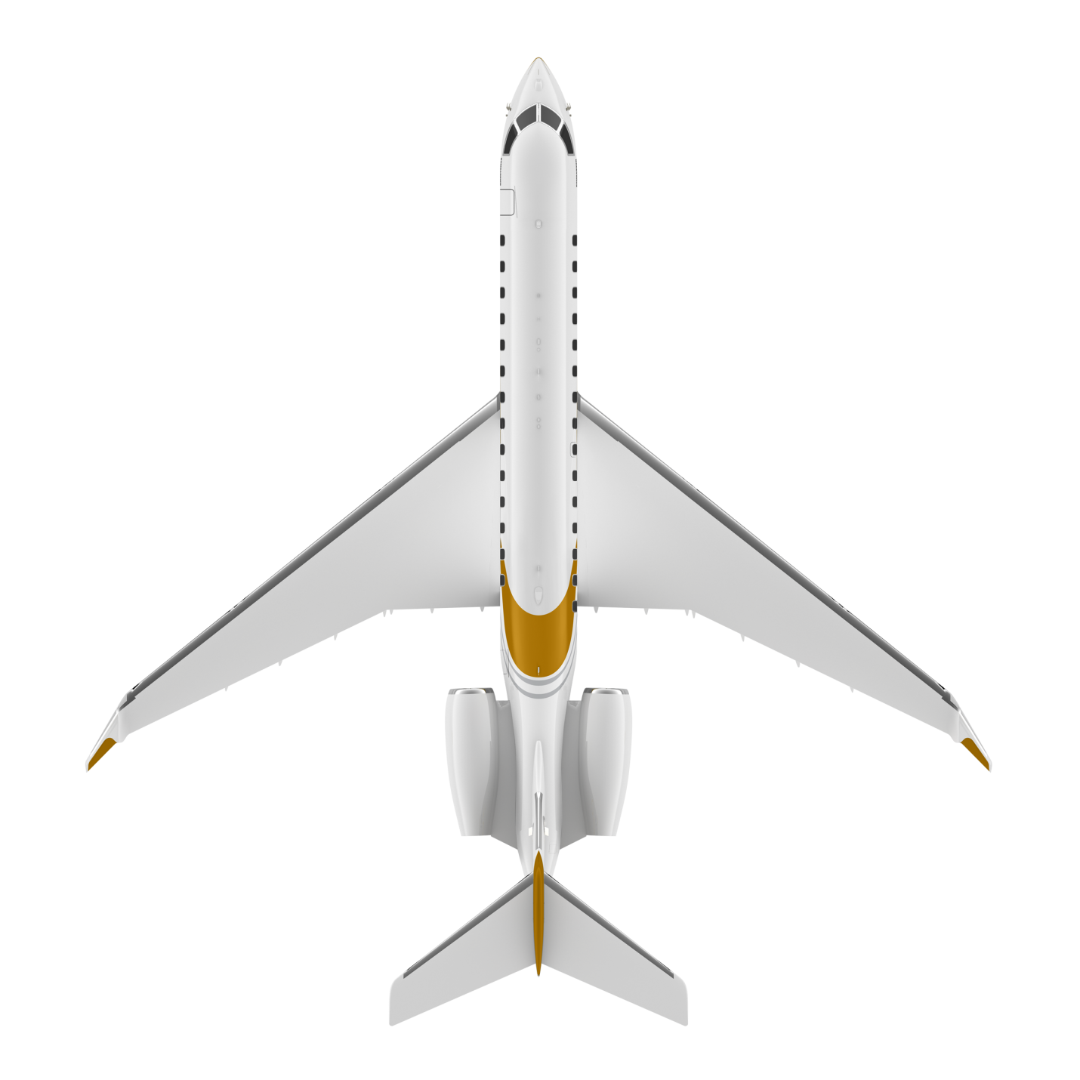
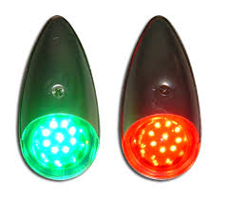
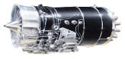
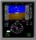

GKN Fokker Elmo KBE Assignment 2022 EWIS
Electrical Wiring Interconnection System (EWIS)
Transport electrical signals through an aircraft
EWIS design
Aircraft & systems
Production breaks
Wire harnesses

Slide 3
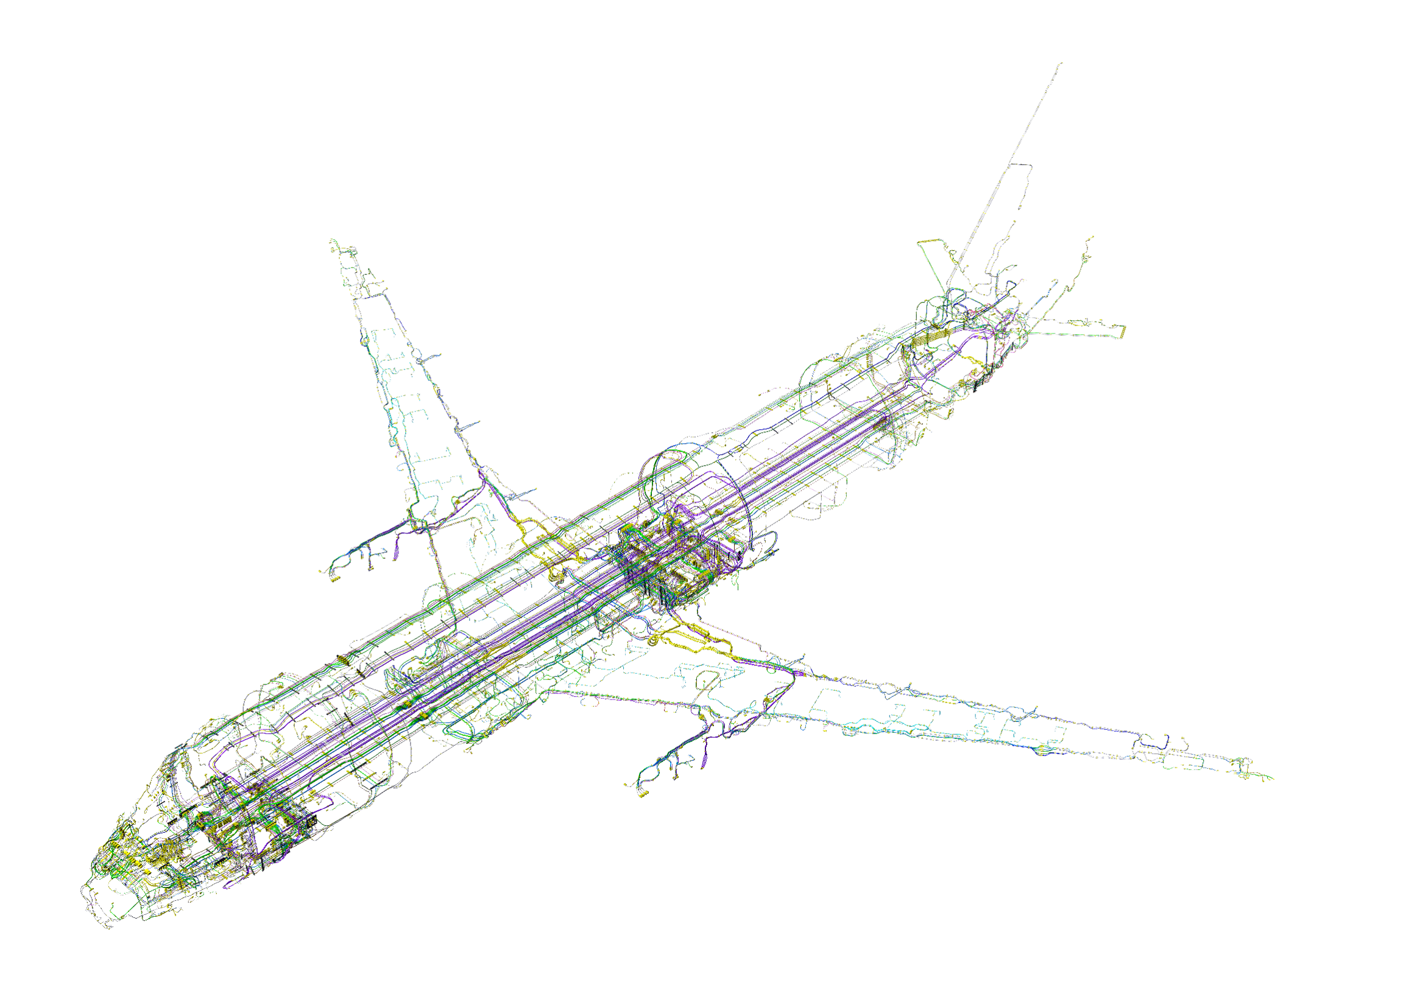
GKN Fokker Elmo KBE Assignment 2022 EWIS
EWIS design complexity
Geometrical
Space constraints
Integration of all aircraft systems
Particular risk analysis (rotor burst, rim release, etc.)
Functional
Separation between signals and from other systems
Environmental protection
Installation
Quantity
~9000 signals
~18000 cables
→ 50km wiring
Configuration management
Continuous changes & different aircraft configurations

Slide 4
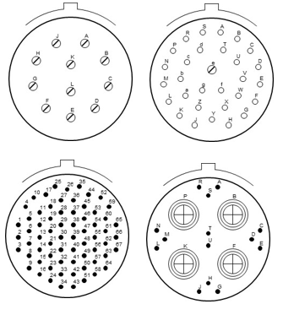
GKN Fokker Elmo KBE Assignment 2022 EWIS
Objectives
The purpose of this assignment is to create an application which, for given bracket size and characteristics and an available set of different types of connectors (shapes) can provide an optimal distribution of connectors on the given bracket, ensuring that the highest amount of wires can be connected at this location.
Optionally, computations can be included to ensure structural integrity of the bracket.
Expected Outcome
A visual representation about of one or more optimal distributions of connectors on the given bracket. The application should both be able to provide an optimal distribution for a given amount and size of connectors (e.g. 4 connectors of size X) as well as for a distribution of connectors from a large library of available connector types and sizes.

Slide 5
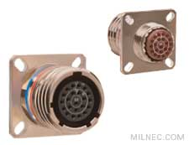
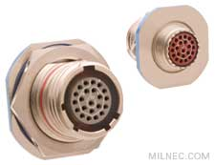
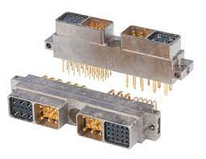
Connector data
Connector STD | Insert Arrangement STD | Shell Size | Insert Size | Max Area | Contact size 22 quantity | Area / contact
MIL-DTL-38999/20 | MIL-STD-1560 | A | 9 | 581 | 6 | 97
MIL-DTL-38999/20 | MIL-STD-1560 | B | 11 | 702 | 13 | 54
MIL-DTL-38999/20 | MIL-STD-1560 | C | 13 | 835 | 22 | 38
MIL-DTL-38999/20 | MIL-STD-1560 | D | 15 | 980 | 37 | 26
MIL-DTL-38999/20 | MIL-STD-1560 | E | 17 | 1129 | 55 | 21
MIL-DTL-38999/20 | MIL-STD-1560 | F | 19 | 1354 | 66 | 21
MIL-DTL-38999/20 | MIL-STD-1560 | G | 21 | 1600 | 79 | 20
MIL-DTL-38999/20 | MIL-STD-1560 | H | 23 | 1866 | 100 | 19
MIL-DTL-38999/20 | MIL-STD-1560 | J | 25 | 2144 | 128 | 17
MIL-DTL-38999/24 | MIL-STD-1560 | A | 9 | 731 | 6 | 122
MIL-DTL-38999/24 | MIL-STD-1560 | B | 11 | 973 | 13 | 75
MIL-DTL-38999/24 | MIL-STD-1560 | C | 13 | 1158 | 22 | 53
MIL-DTL-38999/24 | MIL-STD-1560 | D | 15 | 1359 | 37 | 37
MIL-DTL-38999/24 | MIL-STD-1560 | E | 17 | 1576 | 55 | 29
MIL-DTL-38999/24 | MIL-STD-1560 | F | 19 | 1924 | 66 | 29
MIL-DTL-38999/24 | MIL-STD-1560 | G | 21 | 2181 | 79 | 28
MIL-DTL-38999/24 | MIL-STD-1560 | H | 23 | 2454 | 100 | 25
MIL-DTL-38999/24 | MIL-STD-1560 | J | 25 | 2734 | 128 | 21
EN4165-004 | EN4165-001 | 2 module | EN4165 | 845 | 40 | 21
EN4165-004 | EN4165-001 | 4 module | EN4165 | 1309 | 80 | 16

Slide 6
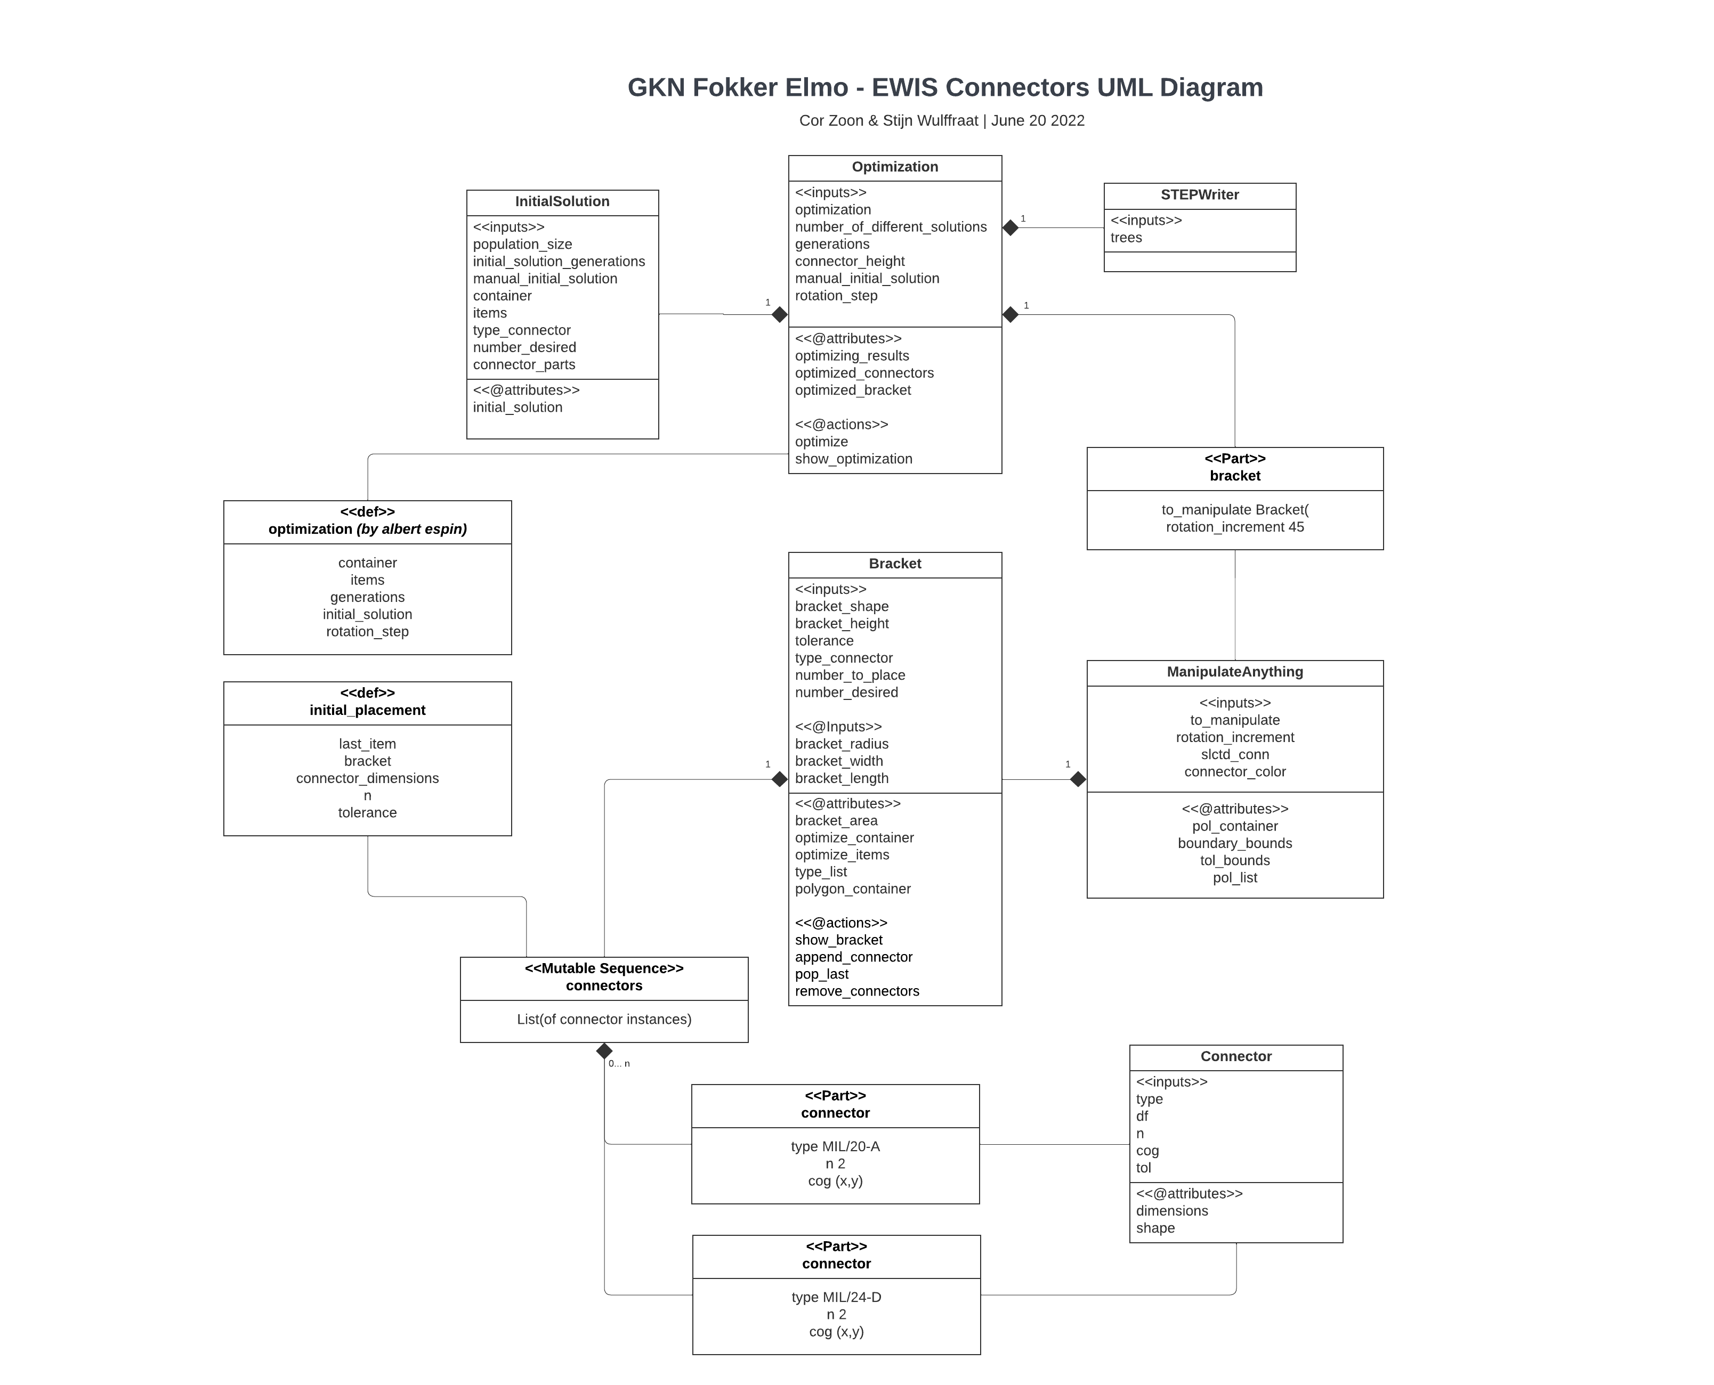
UML Diagram

Slide 7
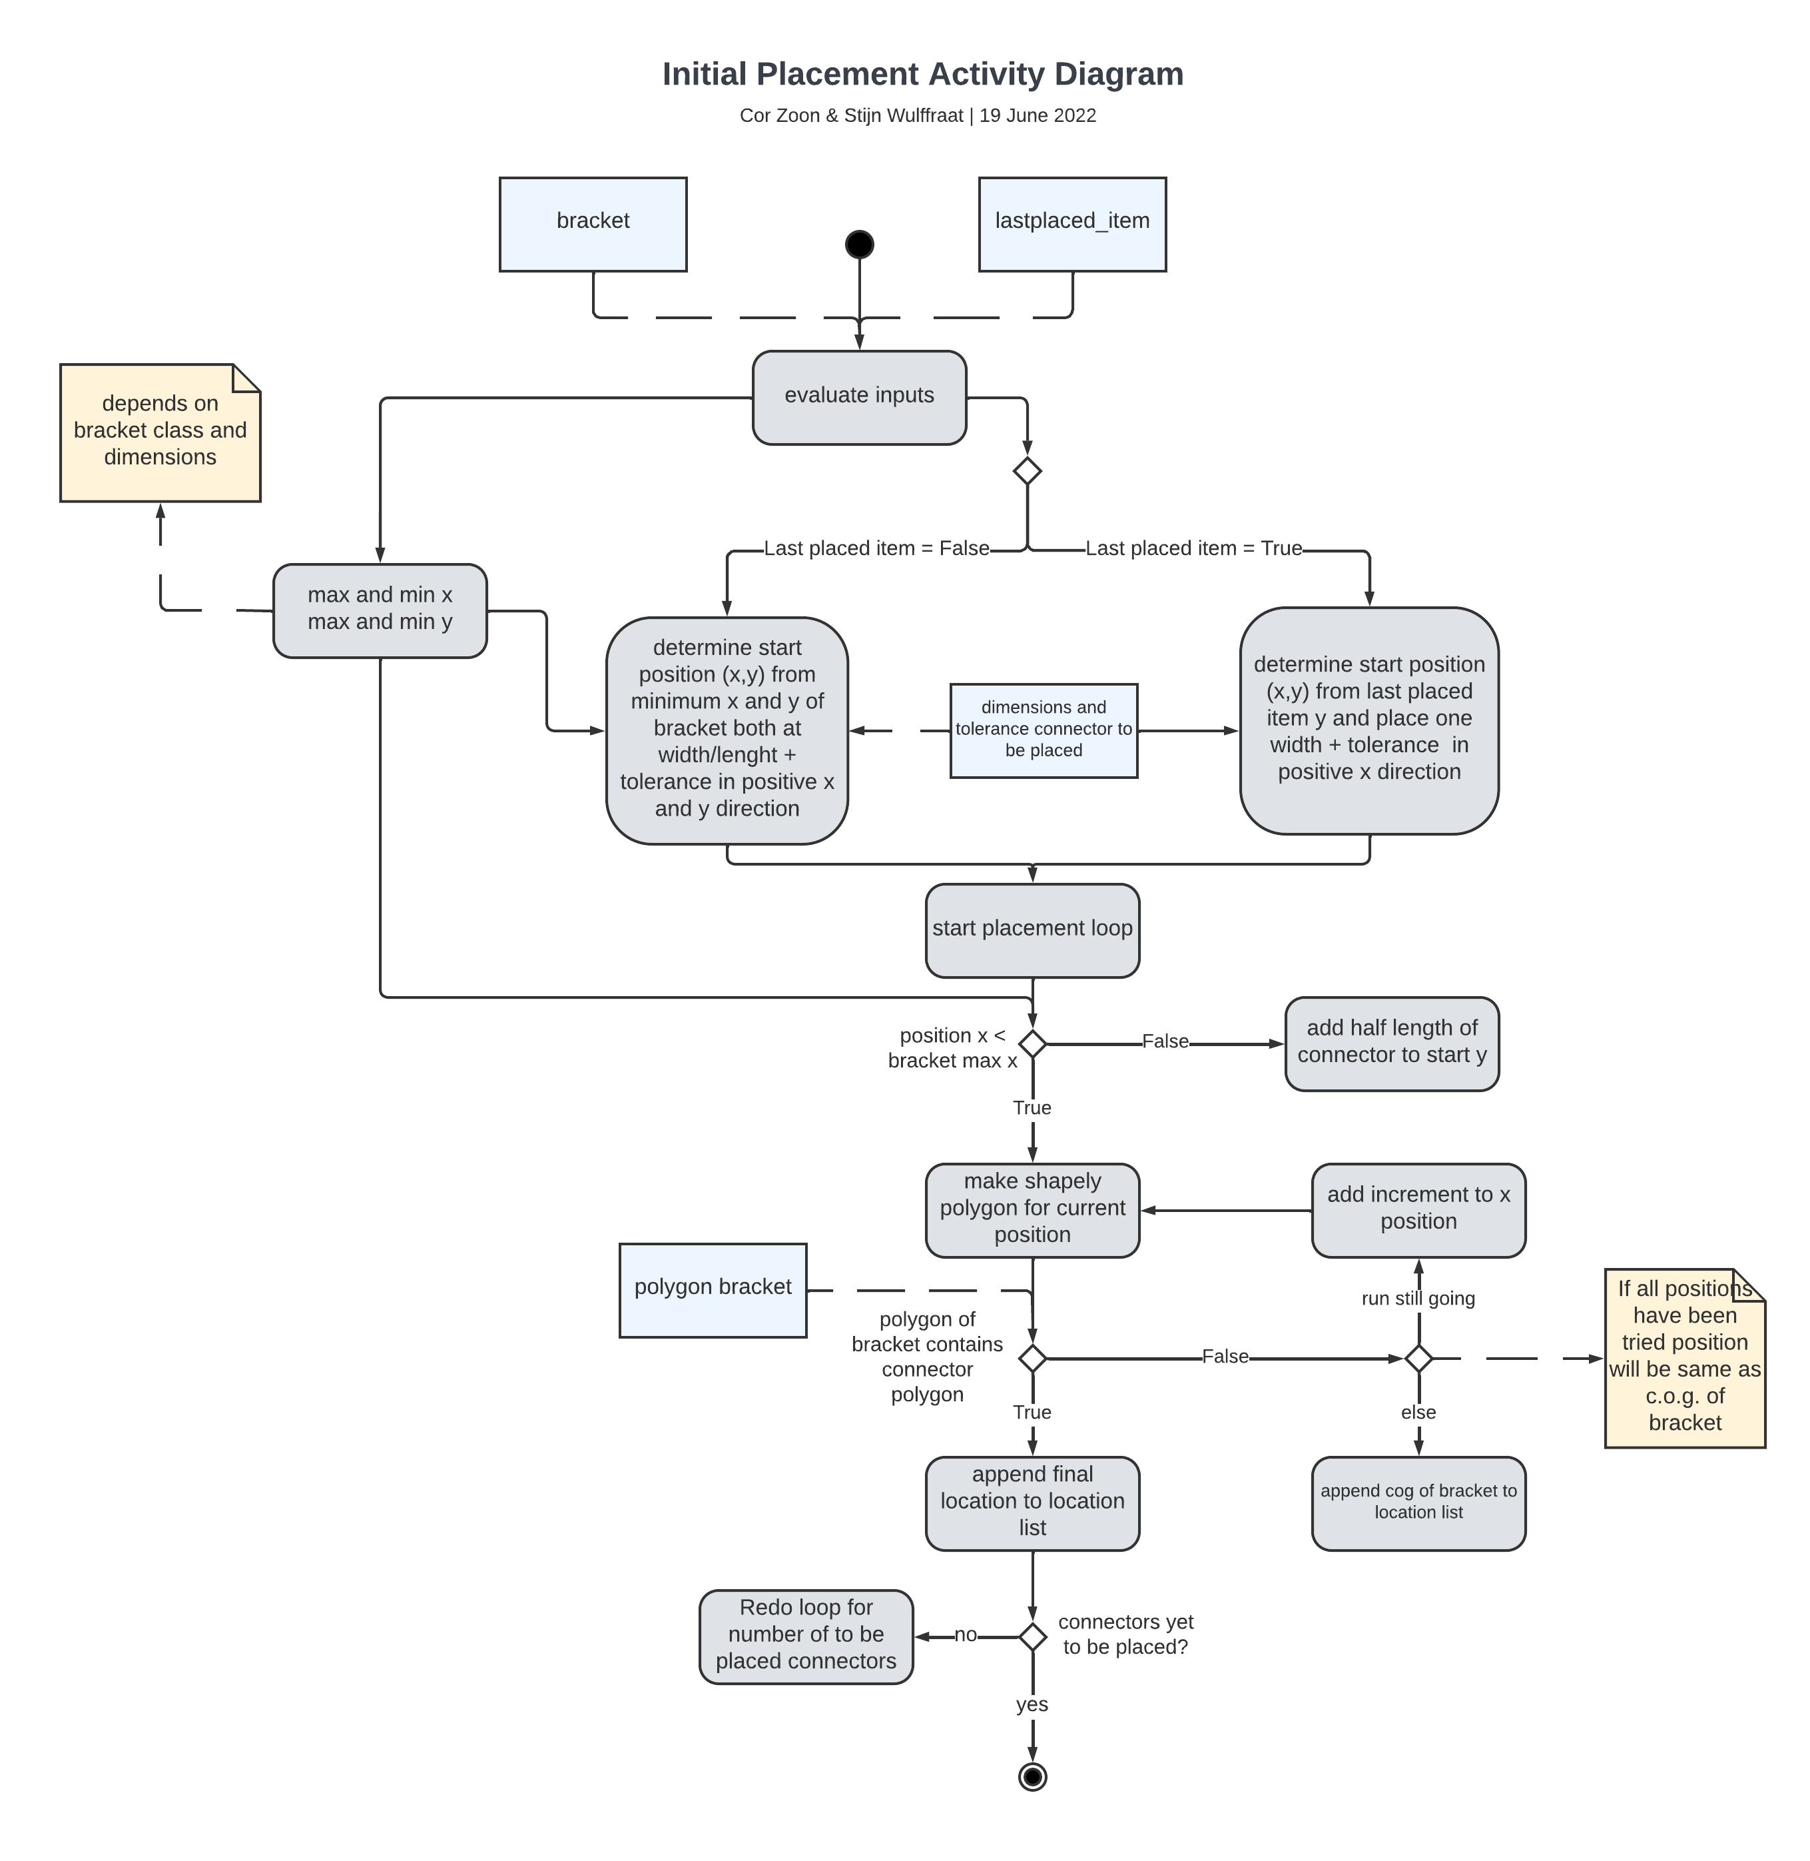
Activity Diagram

Slide 8
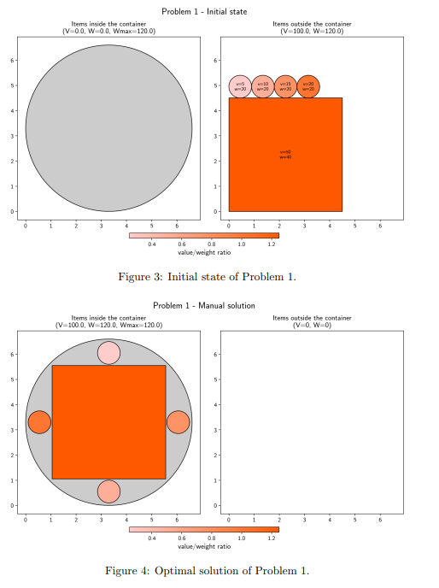
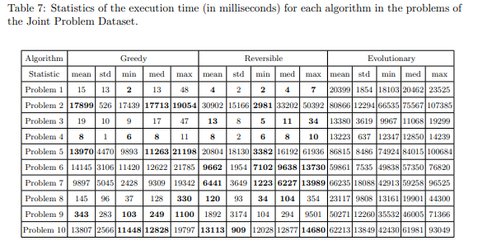
Source Algorithm – Albert Espin
https://github.com/albert-espin/knapsack-packing#an-evolutionary-algorithm-for-solving-the-two-dimensional-packing-problem-combined-with-the-01-knapsack-problem [1]

